Slide 1
Recsen
Imagine walking into a massive store with millions of products and having a personal assistant who knows your tastes, suggesting exactly what you'd love to buy next. Now, think about how valuable it would be if that same assistant could also interpret your emotions and preferences to improve your shopping experience even further. This is the power of product recommendation systems and sentiment analysis. Today, we'll explore these fascinating technologies that are transforming how we interact with online stores and services, making our shopping experiences more personalized and intuitive. Let's dive in and uncover the magic behind the algorithms that understand and cater to our unique preferences."

Slide 2

Recommendation System

Slide 3
What is recommendation system?
Recommender systems are sophisticated algorithms designed to provide product- relevant suggestions to users.
Recommender systems play a paramount role in enhancing user experiences on various online platforms, including e-commerce websites, and social media.
Essentially, recommender systems aim to analyze user data and behavior to make tailored recommendations.

Slide 4
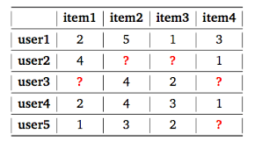
recommendation system phases
URM example
In general, there are three phases for working recommendation system:
Data Collection
Algorithm generation
Presentation

Slide 5
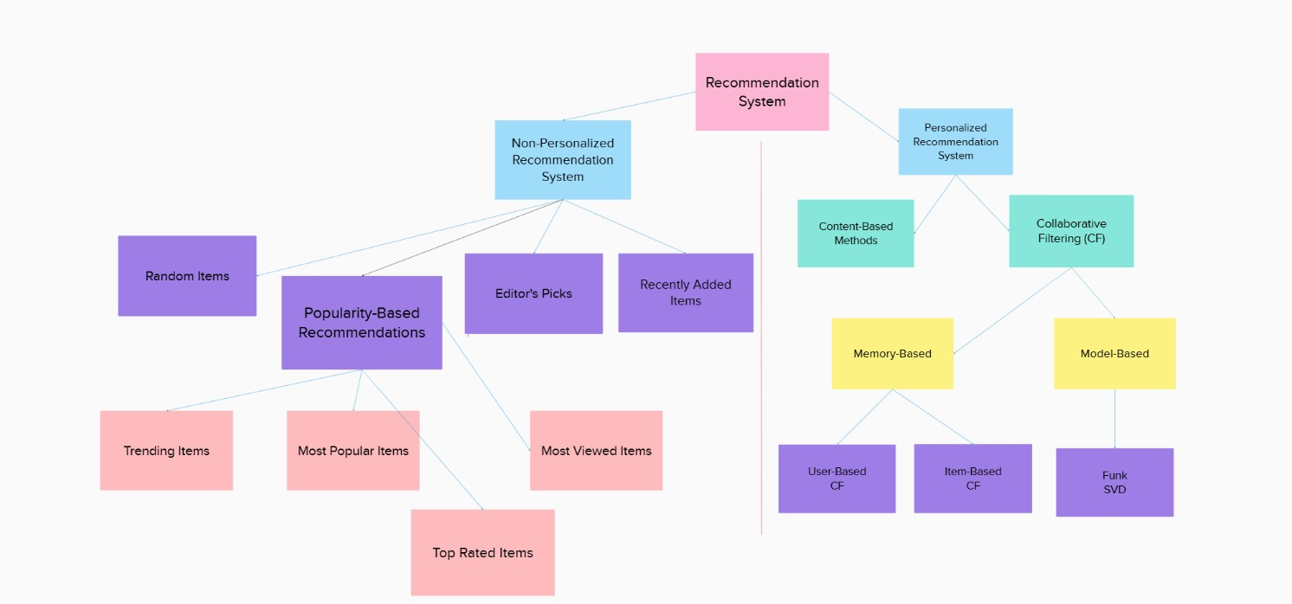
Types of recommender systems

Slide 6
personalized recommender systems:
Personalized recommendation systems are designed to provide tailored recommendations to individual users based on their past behavior, preferences.
these systems predict items that a specific user is likely to be interested in, ensuring personalized recommendations for each individual.

Slide 7
Which personalized recommender system Will we choose?
We trained the most common models on our data and chose the model that has the best accuracy.
We chose surprise library for this task.

Slide 8
What is the surprise?
Surprise is a Python library specifically designed for building and evaluating recommender systems.

Slide 9

why we choose Surprise?
1. Ease of Use
2. Wide Range of Algorithms
3. Performance and Optimization
4. Community and Documentation
5. Evaluation Metrics

Slide 10
Evaluation Metrics:
measure how well our recommendation algorithms are performing.
Help us understand how effective our system is at suggesting relevant items to users.

Slide 11
For our recommendation system, two metrics stand out

Slide 12
Reasons to use both RMSE and MAE together?
Comprehensive evaluation
Outlier sensitivity
Standard practice

Slide 13
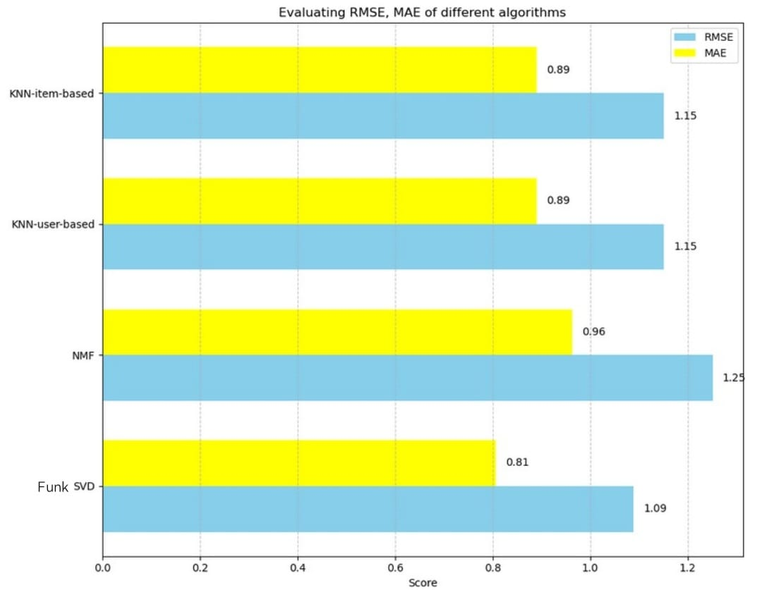
Models Evaluation
{'n_factors': 50, 'n_epochs': 25, 'lr_all': 0.009, 'reg_all': 0.2}

Slide 14
Matrix Factorization and Funk SVD
Matrix factorization is a mathematical technique used to decompose a large matrix into the product of multiple smaller matrices.
Funk SVD (Latent Factor Model) is One of the popular methods of matrix factorization, which has won the Netflix prize competition.

Slide 15
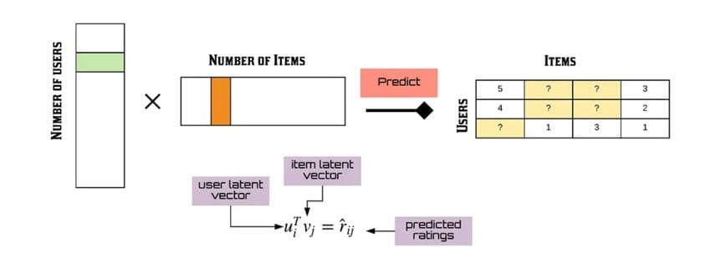
The Funk SVD: aims to predict missing values in a matrix (such as user-item ratings) by decomposing the original matrix into two components:
• User latent factor matrix (U): Contains information about users and their relationships with latent factors.
• Item latent factor matrix (V): Contains information about items and their relationships with latent factors.
R is the approximated rating matrix

Slide 17
How can we determine U and V?
We can solve it as an optimization problem like many machine learning problems.
Here is the loss function that we want to minimize:
This minimization problem can be solved in standard manner by SGD(Stochastic Gradient descent)

Slide 18
Steps to Apply SGD to Minimize the Loss Function:
1. Initialize Parameters
2. Update Parameters for Each Data Point
For each observed user-item interaction (i,j)∈S:
• Calculate the prediction error eij:
• Update the latent factors using the gradients of the loss function with respect to
uis and vjs:
For user latent factors uis:
For item latent factors vjs:
3. Repeat Until Convergence

Slide 19
Example for funk SVD:
Suppose we have the following actual real rating matrix

Slide 20
Initialize Parameters
U
VT

Slide 21
Update Parameters for Each Data Point
Suppose we want to get the rating of the user1 and item2, which has actual rating of 9. We simply multiply the U matrix with the VT matrix for user1 and item2.
Now we calculate the squared error of the prediction.
After that, we update the value of the U and VT matrix using the SGD

Slide 22
After reaching the best U and V
R is the approximated rating matrix
Now if we want to recommend products for a specific user, we will sort the predicted rates for that user and recommend 10 products with the biggest predicted rates

Slide 23
Pros and cons of funk svd
Pros:
Effective personalization
Scalability
No need for item attributes
Cons:
Cold Start Problem:

Slide 24
Cold Start Problem

Slide 25
What is the cold start problem ?
The “cold start problem” is a common challenge that occurs in recommender systems.
It refers to a situation where a system or algorithm runs into difficulties when it has little or no historical data about a user or an item. Obviously, this makes it challenging to provide relevant personalized recommendations.

Slide 26

WHY IS IT IMPORTANT TO ADDRESS THE COLD START PROBLEM?
1.Better user engagement.
2. Improved user satisfaction.
3. Discoverability.

Slide 27
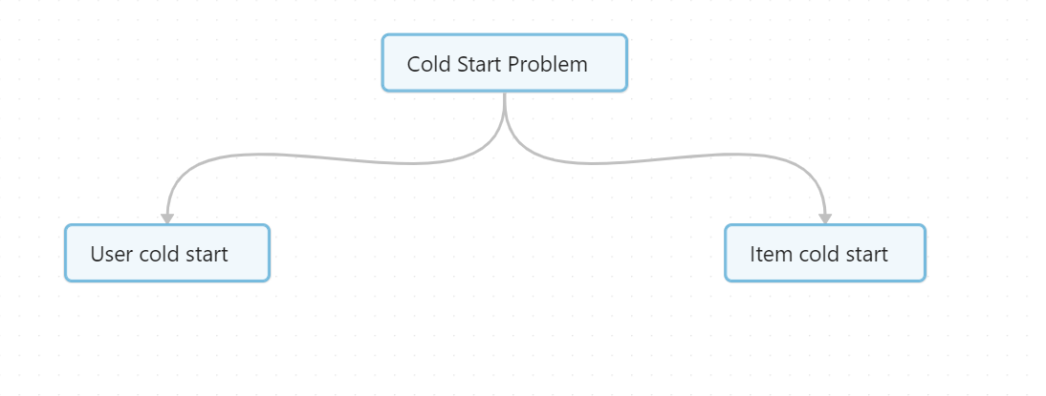
Types of Cold start problem
User cold start: When a user first becomes part of a recommender system, the system has limited information about their preferences and behavior. This makes it difficult to provide personalized recommendations.
Item cold start: New items, such as products or content, may not have accumulated enough user interactions or ratings to generate accurate recommendations. As a result, the system may struggle to recommend these new items effectively to the users in the system.
In our Project we will focus on solving the user cold start problem [There is no new items will be added]

Slide 28
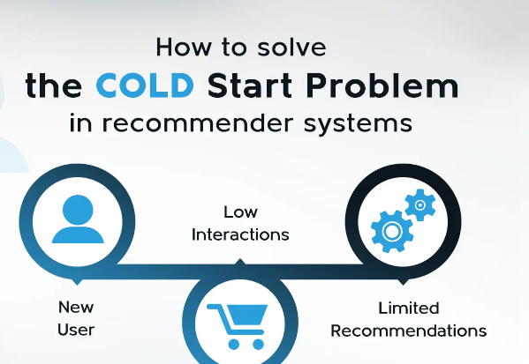
How to solve the cold start problem with respect to our needs

Slide 29
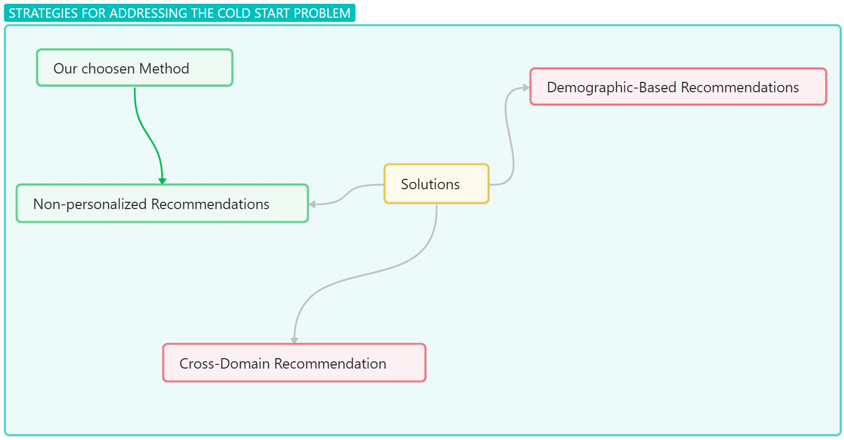
There is many strategies to solve the cold start problem.
To solve the user cold start problem specifically, the focus is on generating relevant recommendations for new users who have limited or no historical interaction data

Slide 30
Demographic-Based Recommendations :
Recommend items based on the user's age, gender, location, etc.
Advantages :
Provides a starting point for recommendations when no interaction data is available.
Disadvantages:
Risks stereotyping .
Privacy concerns .
Cross-Domain Recommendation :
Use data from other domains (e.g., a user's movie preferences to recommend books).
Advantages:
Utilizes existing data from different domains to infer preferences.
Provides a richer data set for making recommendations.
Disadvantages:
Data integration .

Slide 31
Non-personalized recommendations
Advantages:
- Immediate Recommendations
- Simplicity
- Scalability
- Data Independence
Disadvantages:
Lack of Personalization
Initial Engagement Only

Slide 32
We choose the Non-personalized as our solution to the cold start problem
What is Non-personalized recommendation system ?
A non-personalized recommendation system is a type of recommendation system that suggests items or content to users based on criteria that are not specific to individual user preferences or behavior. Instead of tailoring recommendations to the tastes, past actions, or specific interests of a particular user, it relies on general metrics that apply broadly across all users.
Non-personalized recommendation systems provide recommendations to users without taking into account their individual preferences or behavior
What makes Non-personalized recommendation system suitable to our project :
It is more simpler solution compared to other solutions.
More customizable than other solutions.
The most realistic solution to our Project

Slide 33
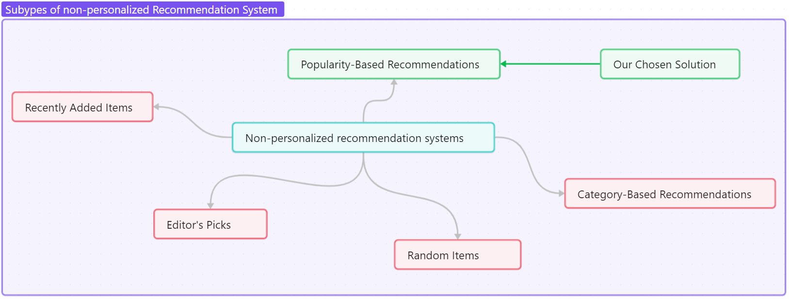
Subtypes of non-personalized Recommendation System
1- Popularity-Based Recommendations
2- Recently Added Items
3- Editor's Picks
4- Random Items

Slide 34
We will choose the Popularity-Based Recommendation
Universal Appeal
- Popular items are likely to be of interest to a wide range of users.
Ease of Implementation
- They require basic aggregation of data on item views, purchases, or ratings, without the need for complex algorithms or extensive user data.
Scalability
- These systems can easily scale to accommodate large numbers of users and items

Slide 35
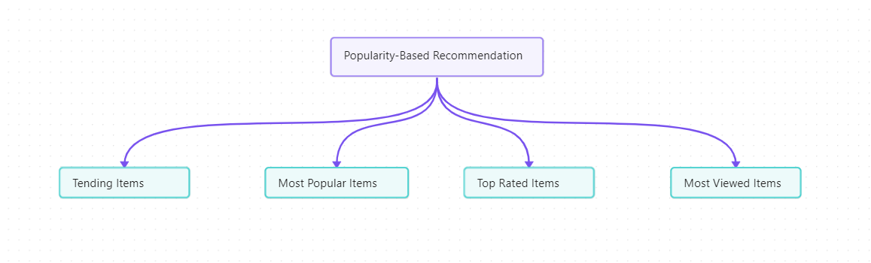
Types of Popularity-Based Recommendation
Most Popular Items
Recommends items that are best-sellers or have the highest sales volume.
Top Rated Items
Suggests items with the highest average ratings.
Most Viewed Items
Recommends items that have been viewed the most by users.
Trending Items
Focuses on items that are currently gaining significant attention or popularity.

Slide 36
We will use the top-rated items , but why ?
1-Quality Over Quantity
High User Satisfaction
Trust and Credibility
2-Reduced Bias
Diverse Appeal
Fair Representation
3-Relevance and Value
User-Centric
Balanced Perspective

Slide 37
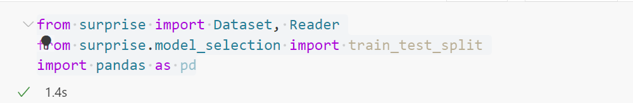
The Code of Our Popularity -Based Recommendation
1. Importing Libraries
Dataset: A module in Surprise for handling datasets.
Reader: A class for parsing a dataset.
train_test_split: A function for splitting a dataset into training and testing sets.
Pandas Library: A powerful data manipulation and analysis library for Python.

Slide 38
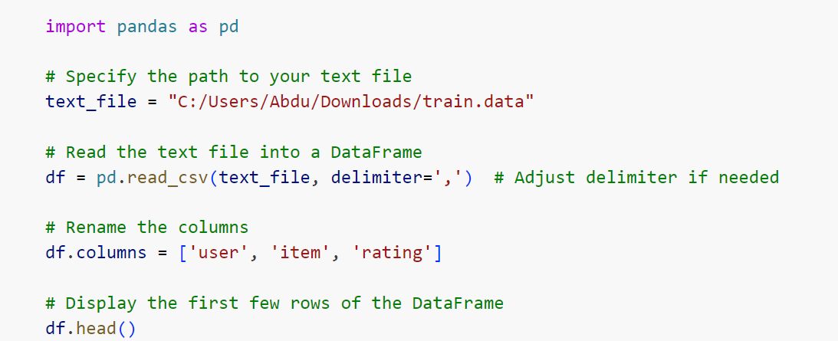
2. Loading the Data
text_file: The file path to the dataset.
pd.read_csv(text_file, delimiter=','): Reads the CSV file into a pandas DataFrame. The delimiter=',' specifies that the file is comma-separated.
Renaming Columns: Sets the column names of the DataFrame to user, item, and rating.
df.head(): Displays the first few rows of the DataFrame to verify the data.

Slide 39
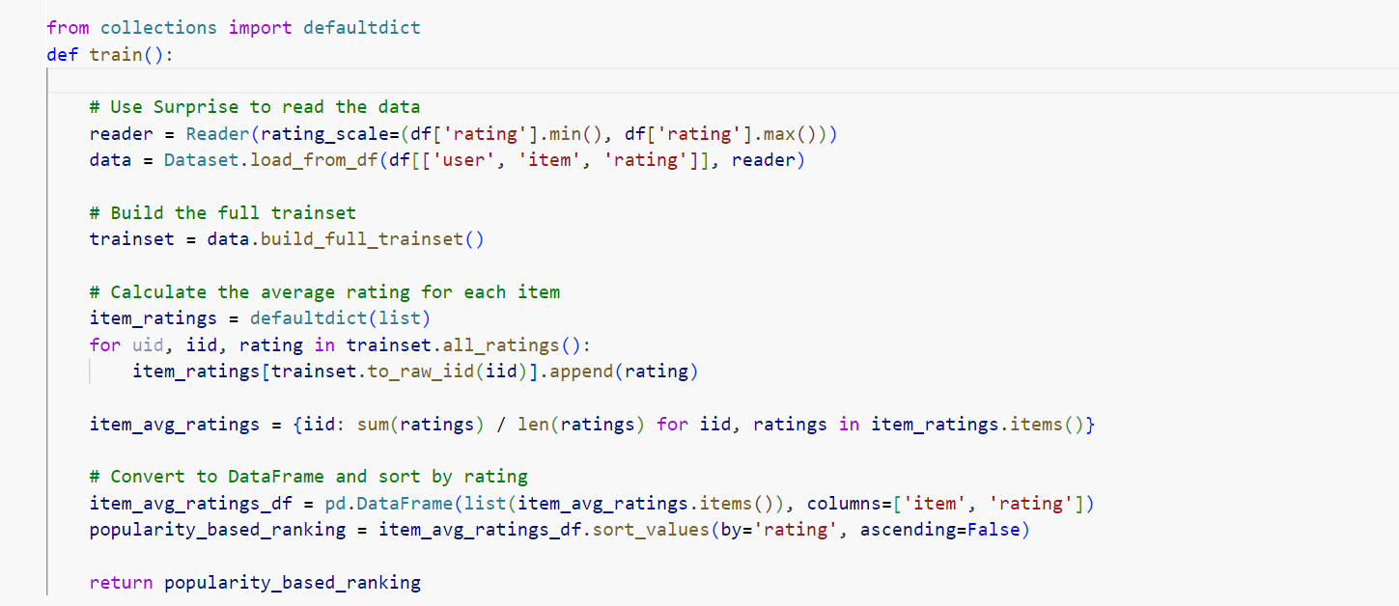
3. The train function

Slide 40
defaultdict: A subclass of Python's built-in dictionary that provides a default value for a nonexistent key.
Defines a function named train which will perform the task of building a popularity-based recommendation model.
rating_scale=(df['rating'].min(), df['rating'].max()): Initializes the Reader object with the minimum and maximum ratings from the DataFrame df.
Dataset.load_from_df(df[['user', 'item', 'rating']], reader): Loads the DataFrame df into a Surprise Dataset object using the Reader.
data.build_full_trainset(): Converts the entire dataset into a training set.
defaultdict(list): Creates a dictionary where each key is an item ID and the value is a list of ratings.

Slide 41
Loop through all ratings:
item_ratings[trainset.to_raw_iid(iid)].append(rating): Append the rating to the list of ratings for the corresponding item.
{iid: sum(ratings) / len(ratings) for iid, ratings in item_ratings.items()}: Creates a dictionary where each key is an item ID and the value is the average rating for that item.
pd.DataFrame(list(item_avg_ratings.items()), columns=['item', 'rating']): Converts the dictionary of item average ratings into a pandas DataFrame.
item_avg_ratings_df.sort_values(by='rating', ascending=False): Sorts the DataFrame by the rating column in descending order.
Return: The function returns the sorted DataFrame popularity_based_ranking

Slide 42
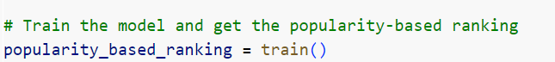
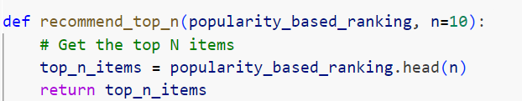
4.Function Call
This line calls the train function, which you have defined previously. The train function performs several tasks related to processing the dataset and calculating item popularity.
5. recommend the top n items
Usage: It is a straightforward utility function that extracts the top items from a sorted list.
Flexibility: By allowing n to be a parameter, the function offers flexibility

Slide 43
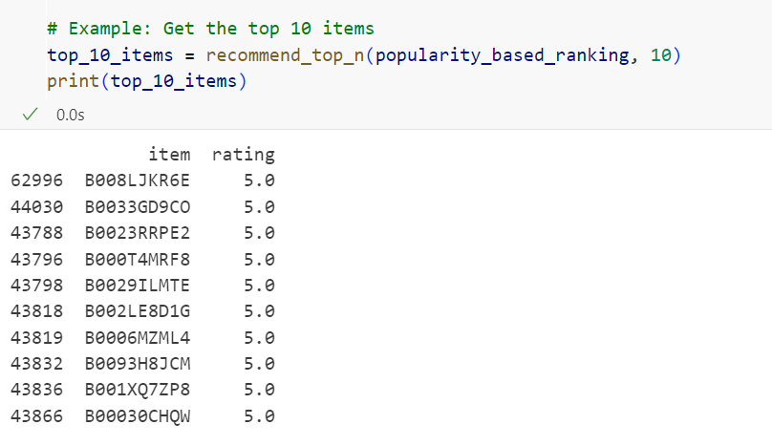
6.Example
Purpose: The example demonstrates how to use the recommend_top_n function to get the top 10 items.
Flexibility: By changing the second argument (n=10) in the function call.
Output: The printed top_10_items DataFrame will display the top 10 items.

Slide 44
Sentiment analysis

Slide 45
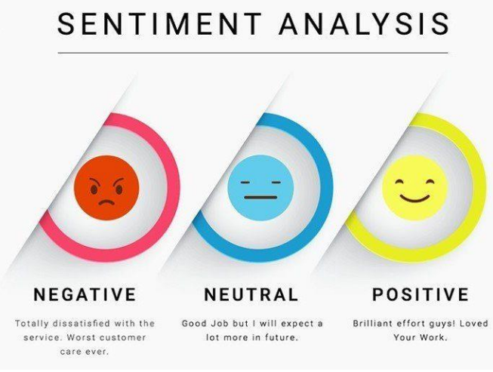

Sentiment analysis
Is a natural language processing (NLP) technique used to determine the emotional tone in the text

Slide 46
Objectives
• Provides more actionable insights for businesses and organizations
• Helps identify customer pain points and areas for improvement
• Enables personalized customer service interactions
• Improves product development and marketing campaigns

Slide 47
Applications
• Analyzing customer reviews and feedback
• Market Research
• Social Media Monitoring
• Financial Markets

Slide 48
Challenges
• Data annotation
• Context dependency
• Ambiguity and sarcasm

Slide 49
Fine-grained Sentiment Analysis
Matrix factorization is a mathematical technique used to decompose a large matrix into the product of multiple smaller matrices.
challenges
expensive and time-consuming
ambiguity and sarcasm

Slide 50
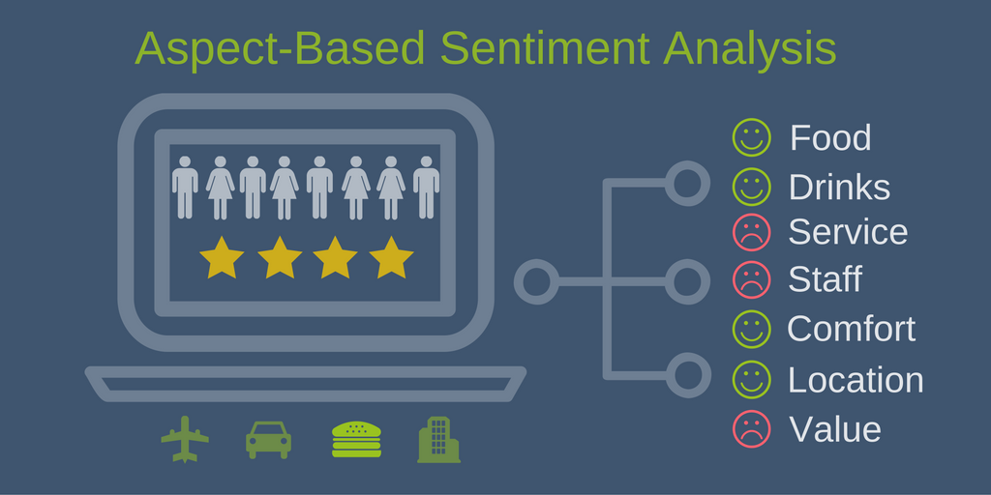
Aspect-level Sentiment Analysis
Type of sentiment analysis that identify sentiments expressed towards specific aspects or features of a product, service, or topic
Why Aspect-level?
aspect-level analysis helps you understand your customers better, which makes your business stronger. It's like having a superpower to see what motivates them!

Slide 51
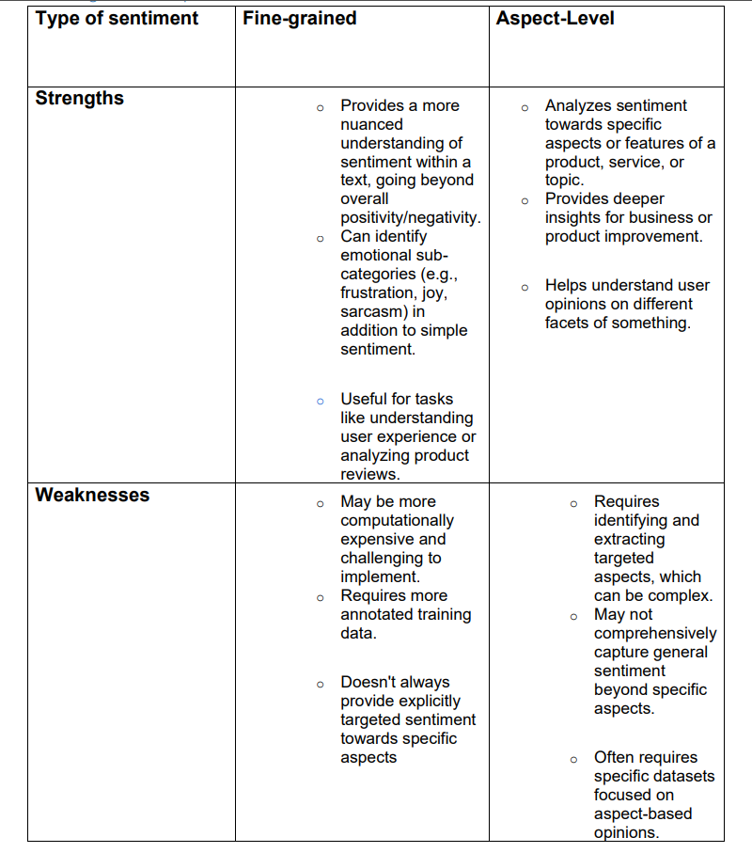


Name
Name
Title or Position
Title or Position

Slide 52

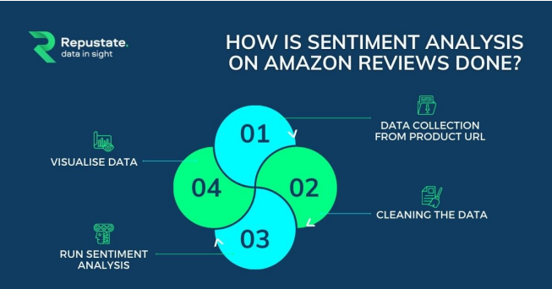
How sentiment analysis done!

Slide 53
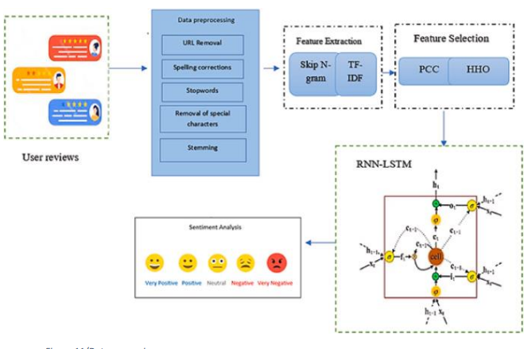
Data preprocessing
Raw data is converted to the required format. The dataset is cleaned up by removing all useless data

Slide 54
Sentiment Analysis Scope
• Document-Level:
Document-Level is about classifying the whole opinion document into sentiments or positive or negative
• Sentence-Level:
Sentence-Level is about classifying sentiment expressed in each sentence
• Aspect-Level:
Aspect-Level plans to characterize the opinion regarding the particular aspects.

Slide 55
Text Processes
Tokenization
Stopword Removal
lemmatization
breaks up text into small chunks called tokens.
Takes out common words which are not useful for sentiment analysis. They provide no meaning.
To transform words back to their root form.

Slide 56
What is Vader?
VADER is a sentiment analysis tool designed for social media text. It assigns a positive, negative, or neutral sentiment to words and then calculates the overall sentiment of a sentence or document based on these scores, VADER is known for its ability to handle sentiment nuances like sarcasm, slang, and emoticons, making it a valuable tool for analysing sentiments in informal online text.

Slide 57

Benefits of Vader
Easy to Use
Handles Informal Text
No Training Needed
Fast Processing
Pre-built Lexicon

Slide 58
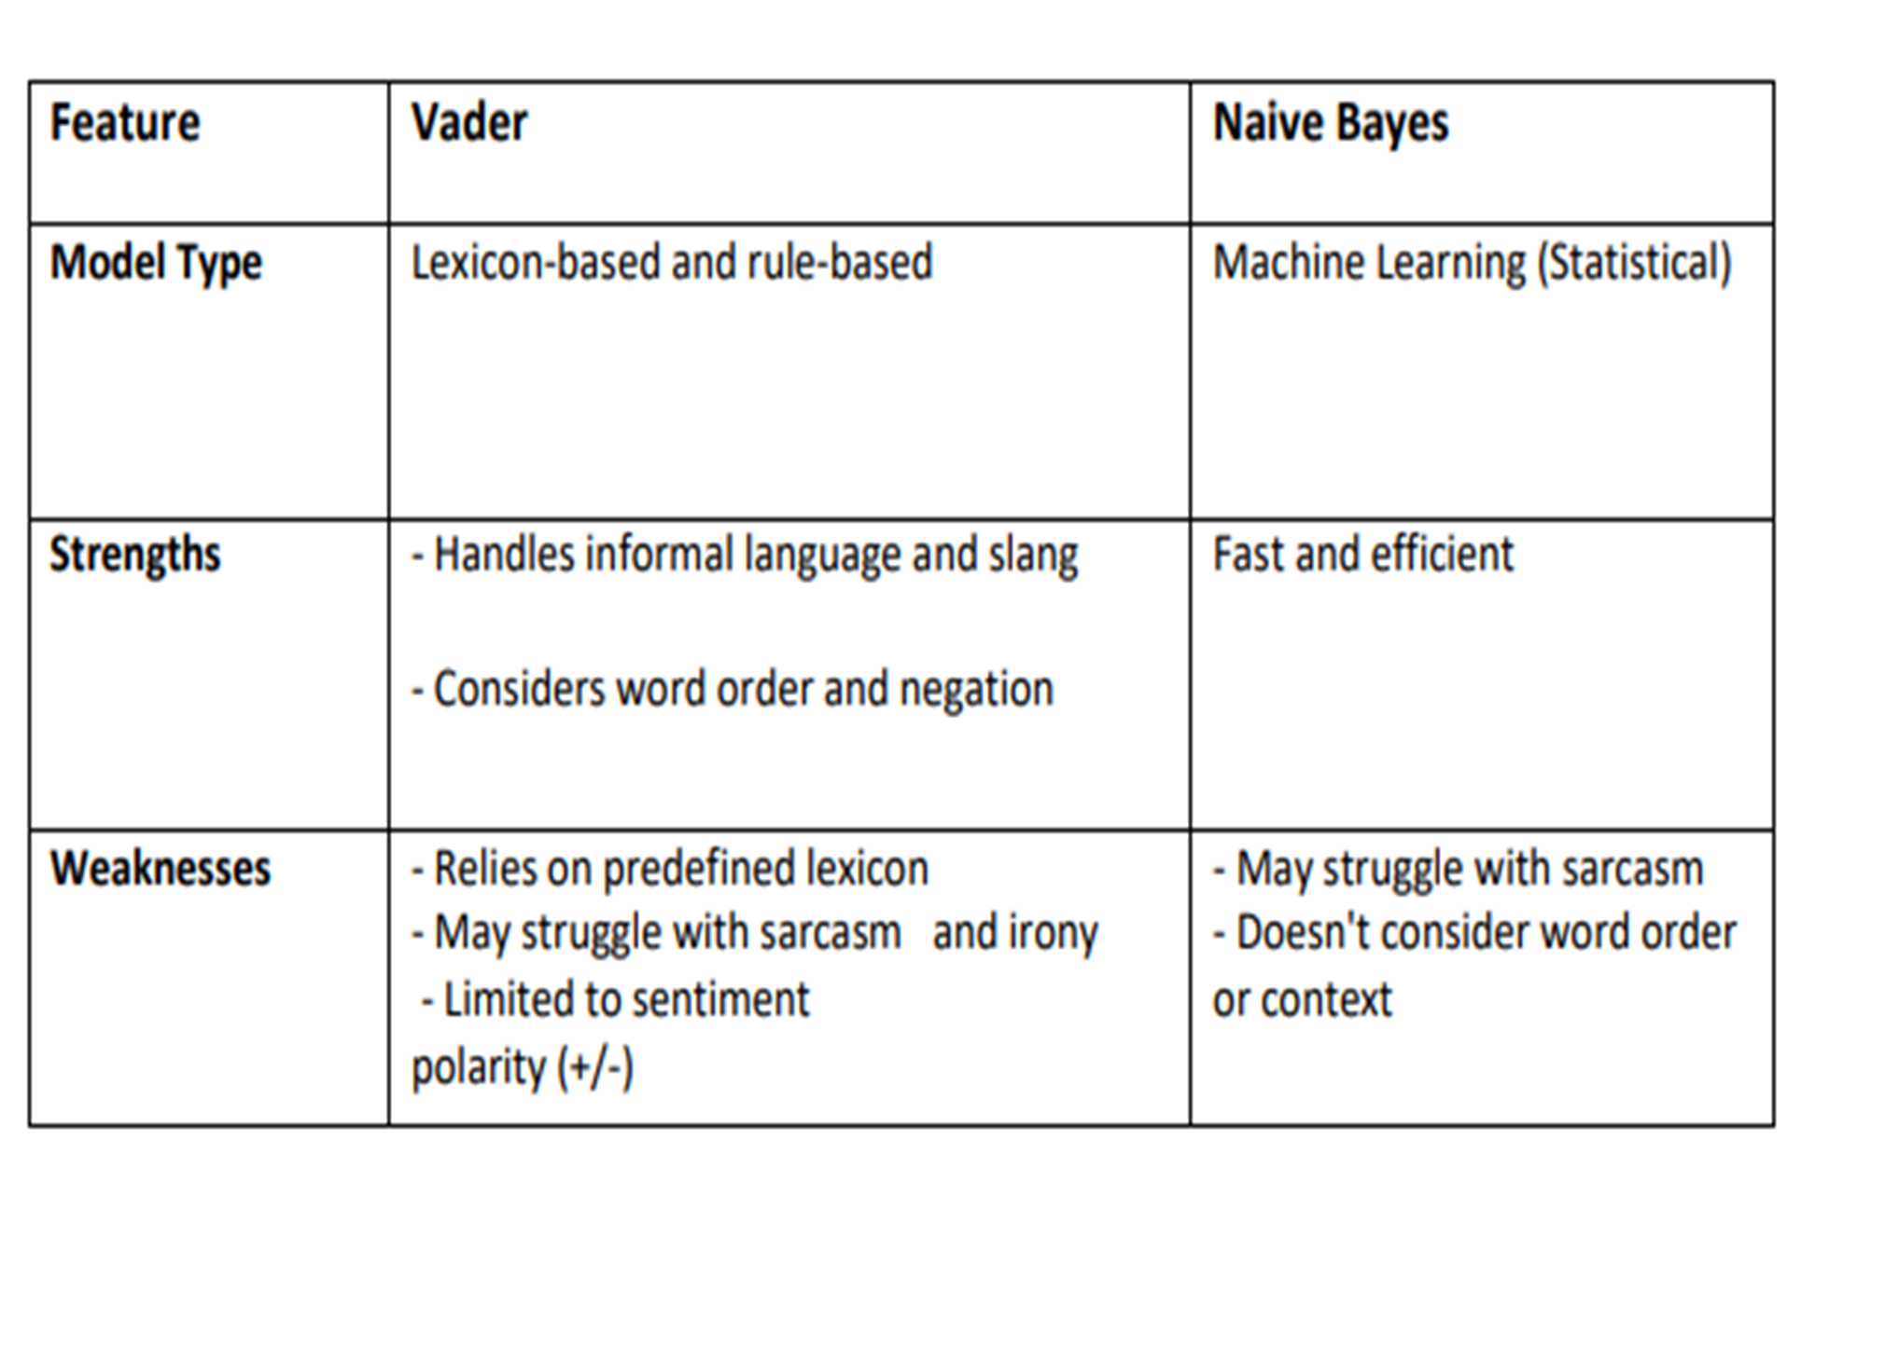

Vader
vs.
Naive Bayes
.

Slide 59
Applying vader
Vader was applied on the “review_text” column from our dataset
calculated the compound score for each review which is the overall sentiment score

Slide 60

How was the compound score divided ?
From -1 to -0.3 was negative
From 0.3 to 1 was positive
Else was neutral

Slide 61
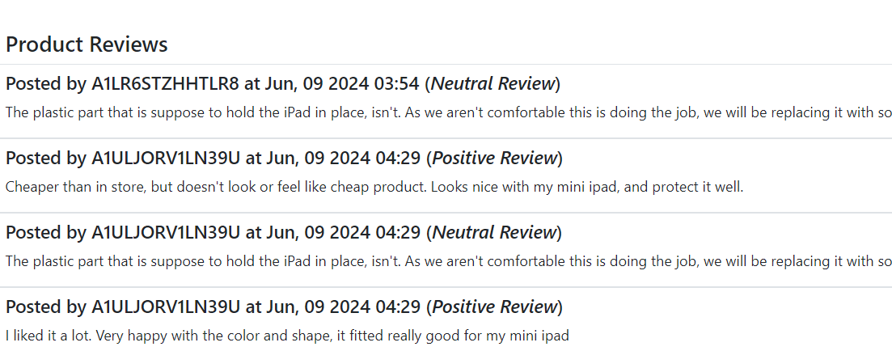
Sentiment score applied
We applied sentiment score on the reviews
get the classification of each review (Positive, Neutral, Negative)

Slide 62
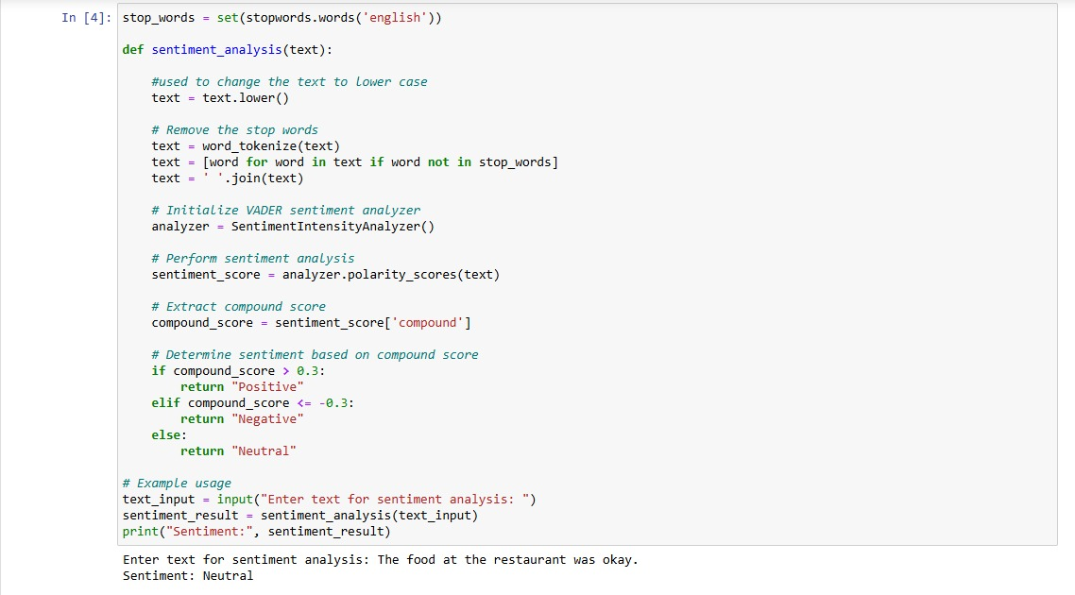
Sentiment the new reviews
The user have the ability to
add review
Add rating
The website have the ability to sentiment the new reviews after added

Slide 63
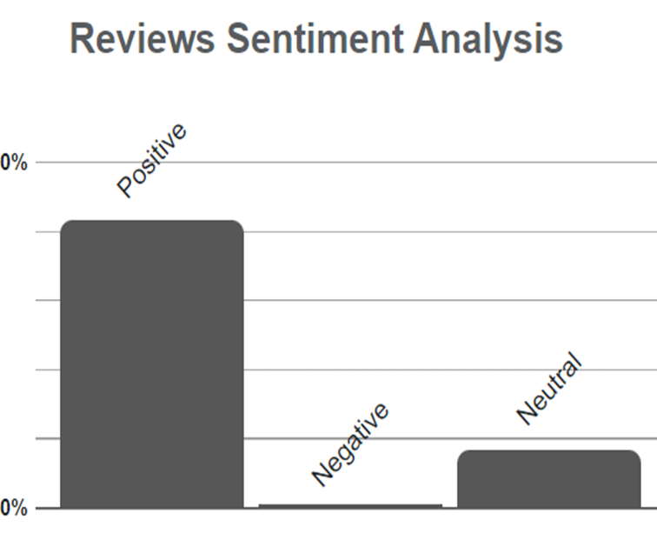
Summarize sentimental reviews
Count to the user the number of reviews in each classification
Easy decision for the user

Slide 64

ABSTRACT
Imagine you are looking for a new laptop online. You type in your query and hit enter. You are greeted by millions of results, each with different features, prices, ratings, and reviews. How do you decide which one to buy? How do you know if you are getting the best deal? How do you avoid wasting hours of your precious time scrolling through endless pages of products?
So, we decide to take this problem and solve it to make it easy for the people to decide

Slide 65
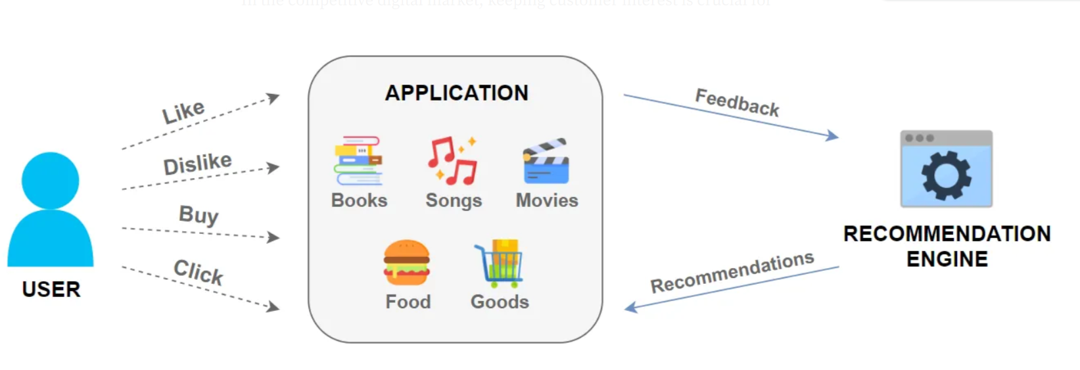

Slide 66
\Table of content
Introduction
Platform Features
Implementing Our Vision
Back end
Front-end

Slide 67
1.Introduction

Slide 68
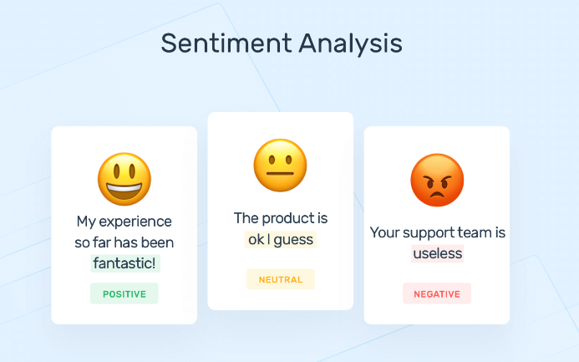
PRPBLEM DEFINTION
The sentiment analysis aims to extract the sentiment or emotion expressed in the customer reviews of the products. The system will use natural language processing (NLP) techniques to transform the text into numerical features and then apply classification algorithms to predict the sentiment polarity.

Slide 69
2. Platform Features
our platform is an interactive with user. Aims to
1.improve the response to user 2.improve the experience for user 3.Make it easy to the user to choose

Slide 70
Platform Features
1. Only about electronics
2. Rating the products
3. Use Sentimental Analysis

Slide 71
Platform Features
4. Live and historical users’ data
5.Recommend products for user
6. Sentimental Analysis Graphs

Slide 72

Platform Feature
Only about electronics.
Our platform only about electronics product like
Laptops
Phones
screens

Slide 73
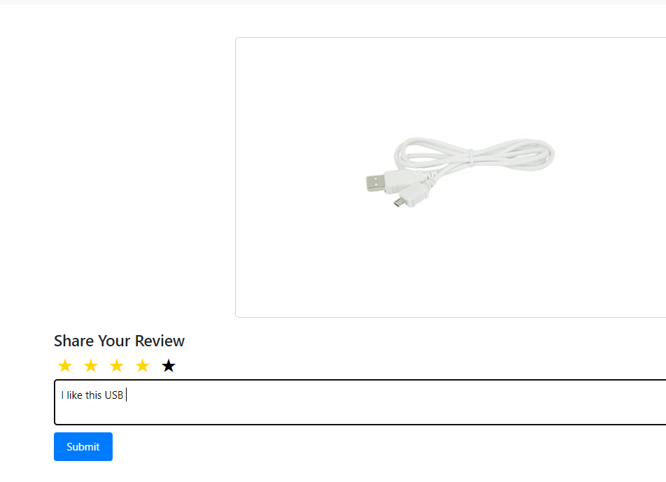
Platform Feature
Rating the products:
The user can rate the products and write a comment for how he find the products?

Slide 74
Platform Feature
Use Sentimental Analysis:
Our platform use Sentimental Analysis to make it easy for the user to make sure from his decision of buying this products by reading the comments from other users on the same product

Slide 75
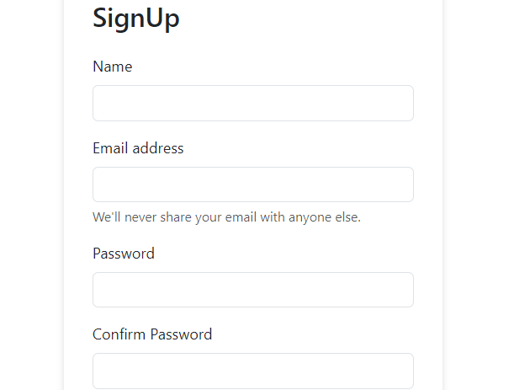
Platform Feature
Live and historical users’ data:
We can trade with users’ data however it is live or historical as we allow to new users to register to our platform

Slide 76
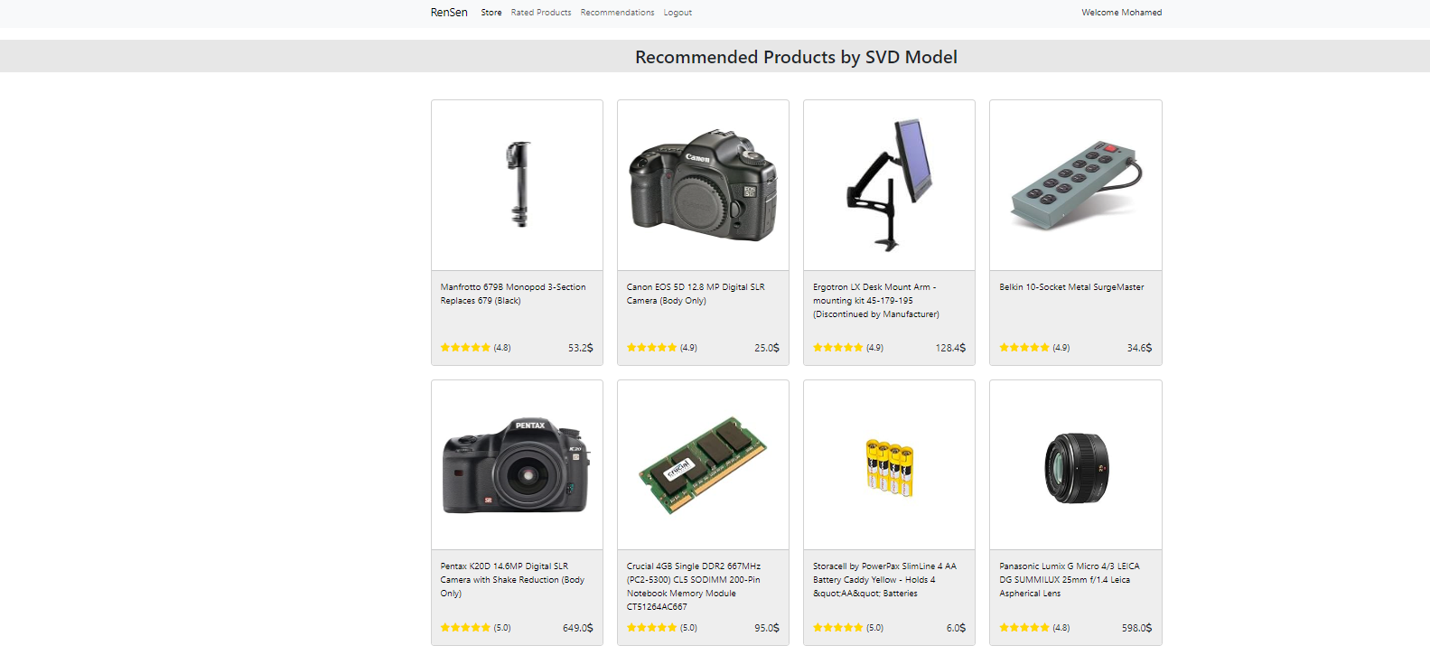
Platform Feature
Recommend products for user:
Our platform recommend to the user products depend on his processes at our platform

Slide 77
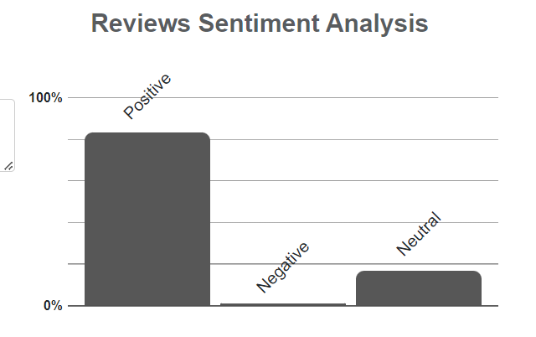
Platform Feature
Sentimental Analysis Graphs:
Our platform shows sentimental Analysis graphs to the users to decrease them time of reading the all comments under the products.

Slide 78
Front end

Slide 79
HTML Header
- Doctype and Language
- Head Section
- Title
- CSS Link Block
- Body Section
- List Items

Slide 80
Login and Signup
- Template Block
- Main Section
- Form Container
- Form Tag
- CSRF Token
- Form Fields

Slide 81
Products
- Template Block
- Header Styling
- Product Loop

Slide 82
CSS
General Styles and Preview Section
- Body Overflow
- Image Styling
- Preview Container
- Thumbnail Navigation
- Tab Content
- Card Component

Slide 83
Product Details and Card Styles
- Flexbox Layout
- Text Transformations
- Highlighting
- Spacing
- Interactive Elements
- Card Styling
- Image Styling
- Card Body
- Links
- Headings and Prices
- Ratings

Slide 84
Review Form Styles
- Form Container
- Text Area and Input Fields
- Buttons
- Review List

Slide 85
JavaScript
The function ‘generateStarRating’ dynamically generates and updates
the star rating for a given element, displaying coloured stars based on the rating value.
Product_rating.JS

Slide 86
Review_Product.JS
the function ‘update_rating’ updates the star rating by first resetting all stars
to uncolored and then colouring the specified number of stars based on the
provided rating value.

Slide 87
Back end

Slide 88
Django Overview
Django is python framework that makes it easier to create web sites.
This framework allows you to create a virtual environment contains from front and backend to create your website.

Slide 89
Django Overview
How does Django Work?
Django follows the MVT design pattern (Model View Template).
Model - the data you want to present, data from a database
View - A request handler that returns the relevant template and content - based on the request from the user.
Template - A text file (like an HTML file) containing the layout of the web page, with logic on how to display the data.

Slide 90



Django Overview
Why Django?
Fast
scalable
security

Slide 91
Django Overview
Django has important python files:
1. settings file: it’s considered as the leader of the project because every single thing we do at the project we should make sure that the settings file read it. It contains from constants that read the blogs and the apps of the projects.
2. Urls file: t is the path of the domain for the website. Every new path I will create for a new app at the project we make sure that the urls file of the project read it.
3. The model file: this is the database file. The database is saved at this file.

Slide 92
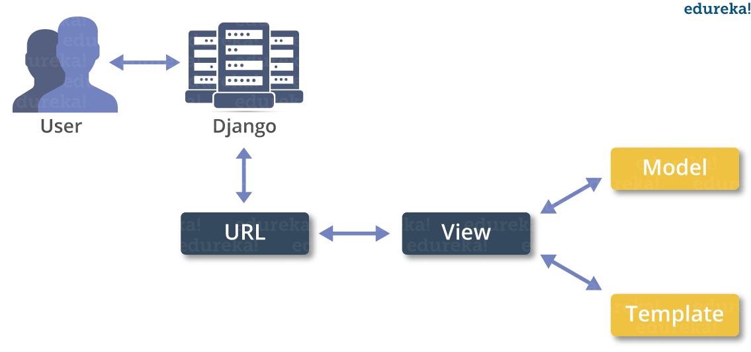
Django
User Request: A user sends a request to the web server URL Dispatcher:
Django’s URL dispatcher receives the request and matches the URL to a view function defined in the URL patterns.
View: The part of Django that handles the request, interacts with the database if needed, and returns the response.
The Template is rendered into a final HTML page, which is sent back to the User as the response.

Slide 93
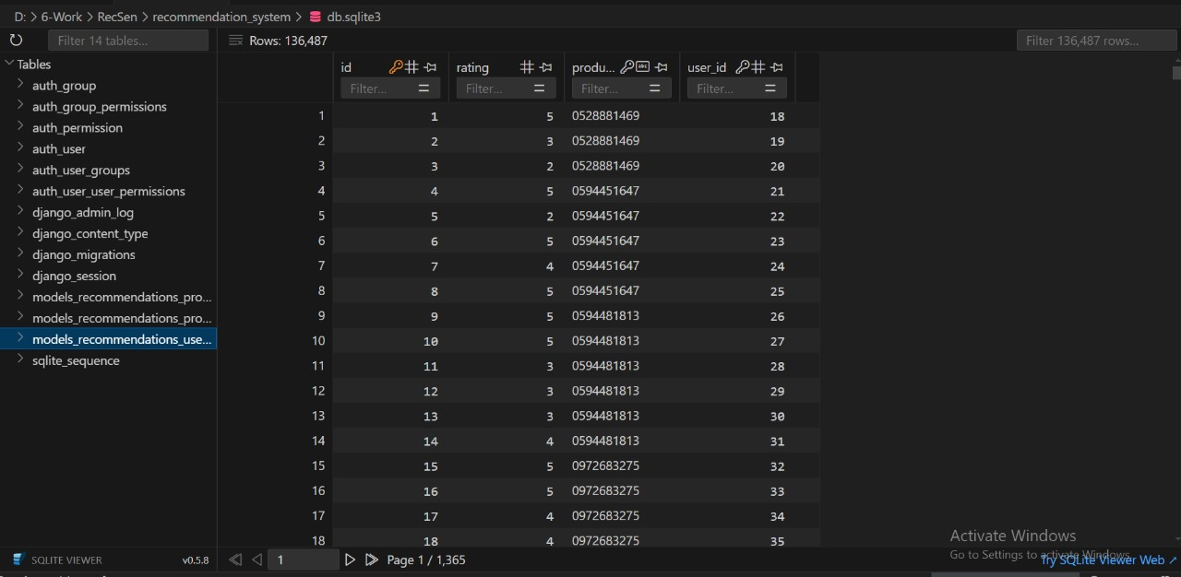

Slide 94
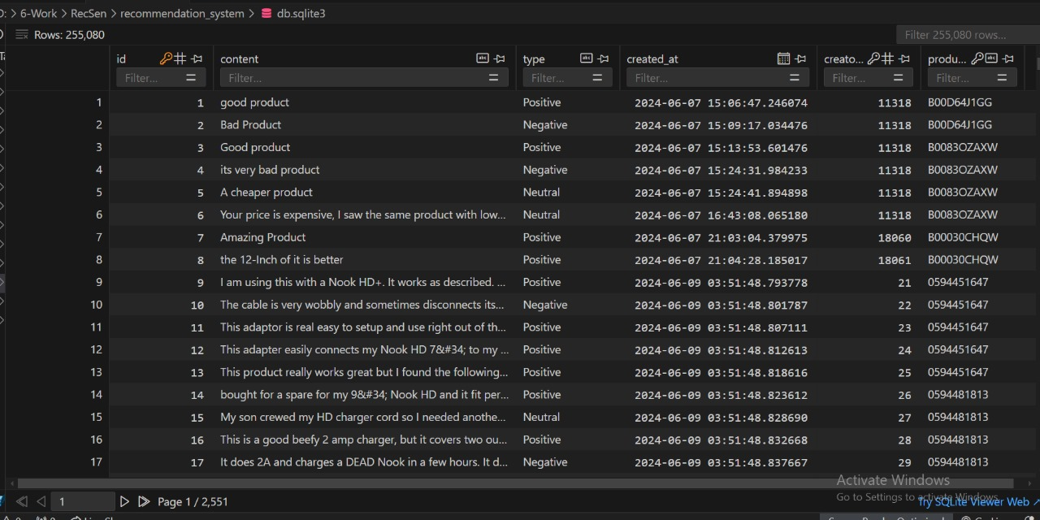

Slide 95
